Slide 1
GSBO city collision data analysis
-Vanteru Sahithi
-Jorge Salas
-Daniel Fyre
-Jin Kang
-Dimithra Rathnayake

Slide 2
Goals
Machine learning
Dashboard

Slide 3
Tasks
Prediction of accidents based on time series data.
Random forest classification based on weather attributes.
Model of Fatalities Locations, weather, date, and time (unsuccessful)
Pedestrian collision hotspots and important factors

Slide 4
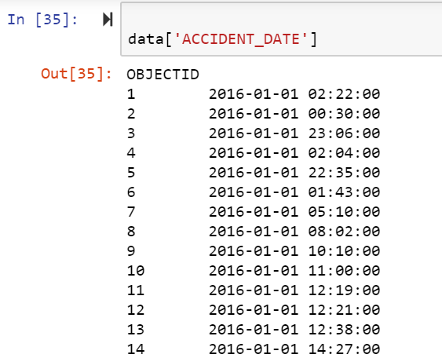
Accidents data from 2014 to 2018 and starting months of 2019.
Time series model.
Used accident_date attribute to retrieve timestamps.

Slide 5
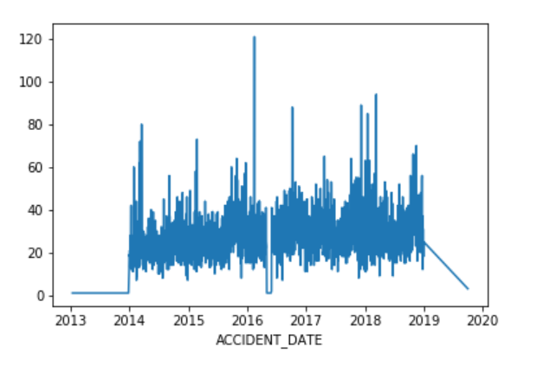

Slide 6
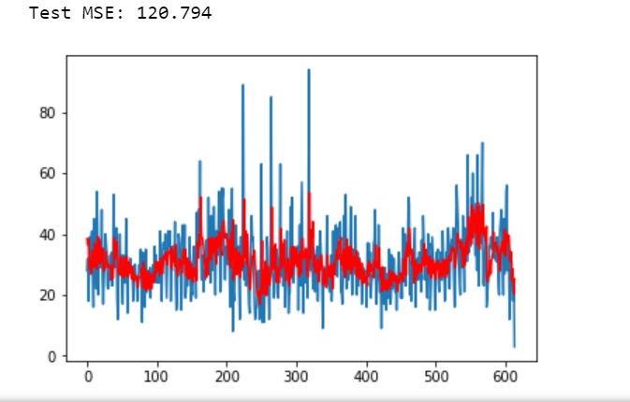
training - 66% data,testing - 34% data.
Predicted trends for years 2019 and 2020.
Y axis - number of accidents.

Slide 7
Random forest classification based on weather attributes.
The weather has levels of severity.
Predicted the type of weather that caused accidents.
Trained data- 75%, test data - 25%.
Compared with KNearest classifier and decision tree classifier. The accuracies are shown below.

Slide 8
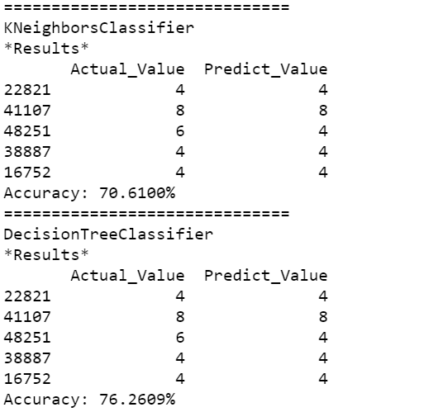
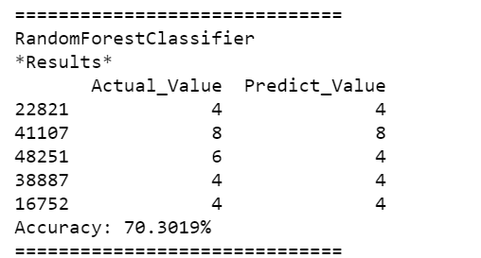

Slide 9
Task
Goal:
Investigate all collisions (2014~2018) related to block populations of Guilford county. (Block population data is from 2018 census)
Question asked:
Which areas are more likely to have collisions per capita?

Slide 10
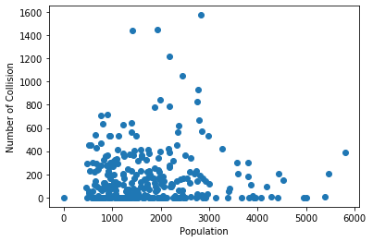

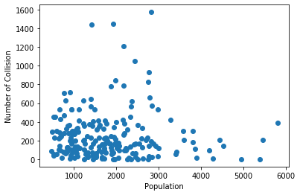
Progress
Since some blocks have populations but no collision, I considered them as outside of Greensboro so I removed.
Also some blocks have high population but small collision data, I considered them as located on the boundary of Greensboro. But, I couldn’t set any standard to sort them out. Therefore, I kept but ignored them in analysis later.

Slide 11
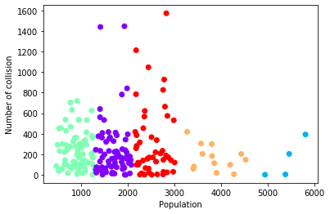
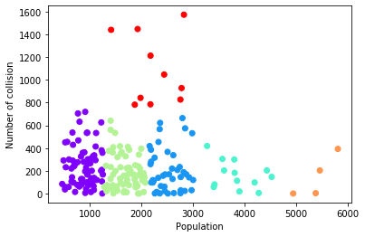
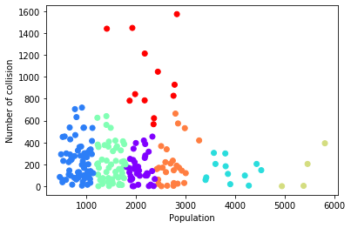
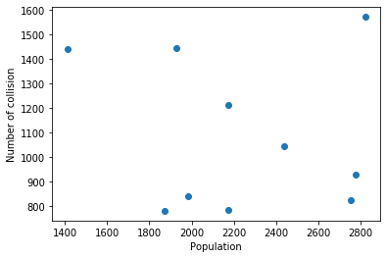
Cluster
KMeans = 5 KMeans = 6 KMeans = 7
Graph of red dots from clustering with KMeans = 6

Slide 12
Red points
Display_Label | Population | Number of Collision
Block Group 2, Census Tract 103 | 1412 | 1447
Block Group 1, Census Tract 164.05 | 1871 | 782
Block Group 2, Census Tract 108 | 1926 | 1440
Block Group 1, Census Tract 160.11 | 1982 | 842
Block Group 2, Census Tract 126.01 | 2174 | 785
Block Group 1, Census Tract 128.04 | 2176 | 1213
Block Group 1, Census Tract 125.09 | 2440 | 1047
Block Group 1, Census Tract 126.09 | 2755 | 827
Block Group 1, Census Tract 128.05 | 2777 | 928
Block Group 1, Census Tract 165.03 | 2823 | 1573

Slide 13
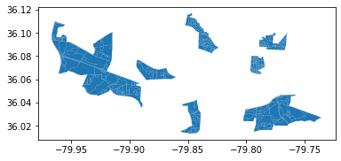
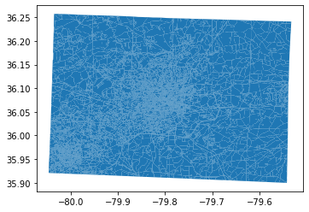
Display of Red Points in Map
Based on population, areas on the right
are more likely to have collisions

Slide 14
Model of Fatalities Locations, weather, date, and time (unsuccessful)
The question was asked to determine whether a certain combination of events has a tendency to cause a crash/fatality. This will be unveiled in the next presentation.
The problems involves using K-means clustering to associate related data and therefore make predictions
The weather data will have to be seperated, the date and time data be reformated, and the coordinates will have to reformated as well for the analysis to work.
So far there are no findings

Slide 15
Goals and Data
Goals
Identify pedestrian collision hotspots
Identify important contributing factors
Data
Latitude and longitude
Weather condition
Light condition
Traffic control
Day of week
Time of accident
Severity of accident

Slide 16
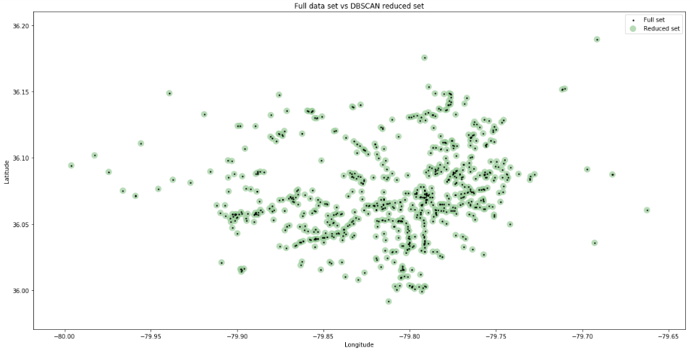
Results
Clustering
DBSCAN

Slide 17
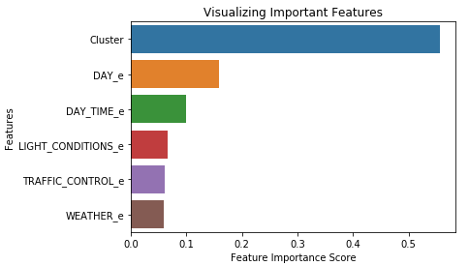
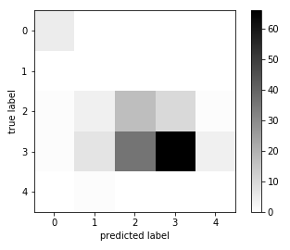
Results
Factor Identification - Severity
Random forest - classification
Accuracy - 0.575
Precision (W. Avg) - 0.74
Recall (W. Avg) - 0.58

Slide 18
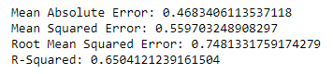
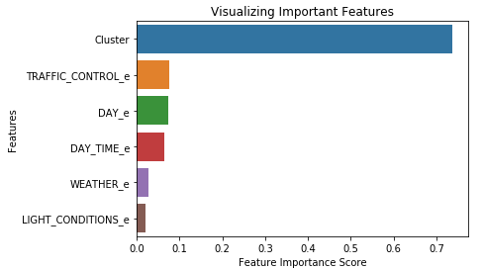
Results
Factor Identification - Collision Count
Random forest - regression

Slide 19
Goals
-Visualization of data
-Complete interactive map using folium
-Implement if possible a slider for Day-Month-Year
-place map(s) into the dashboard

Slide 20
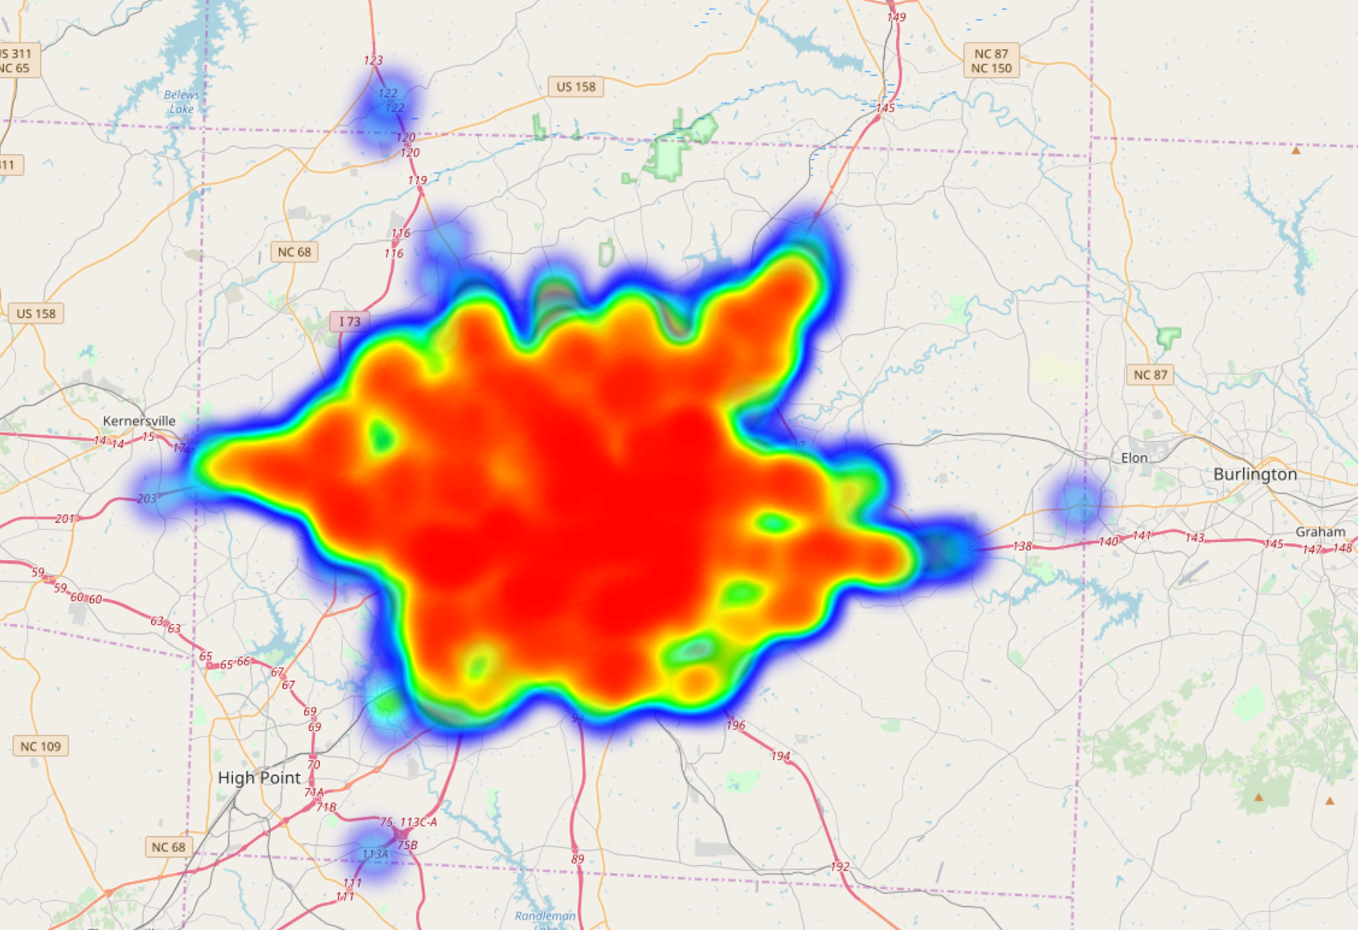

Slide 21
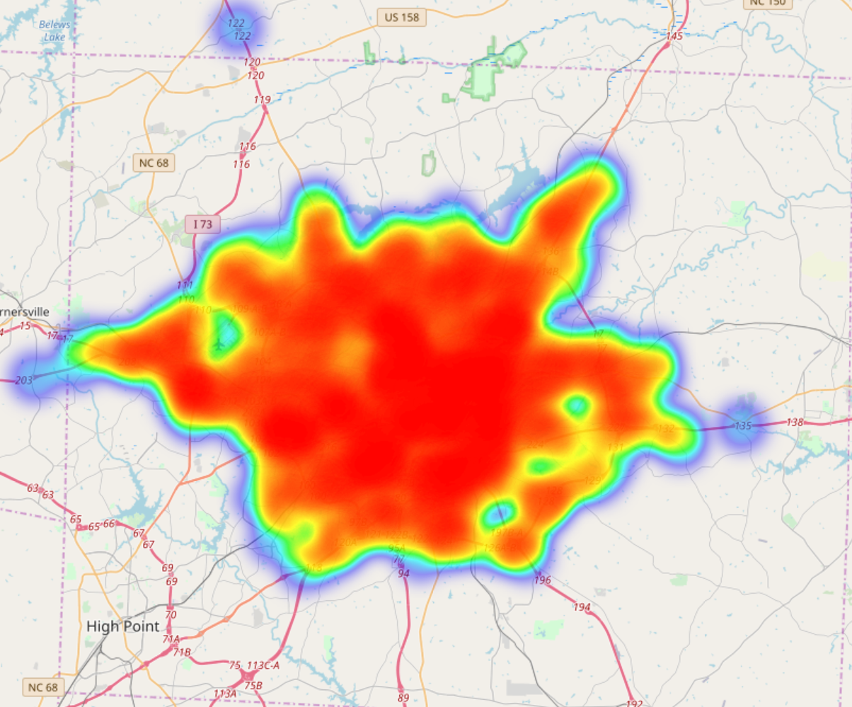
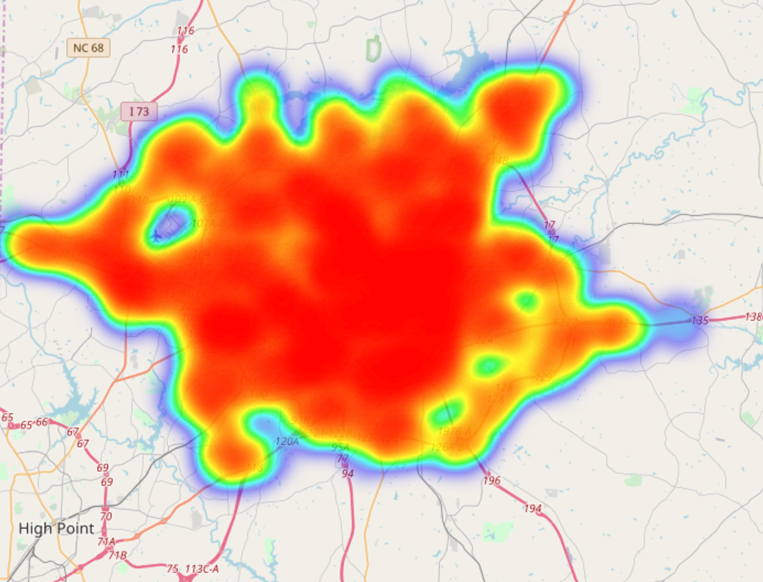
2017 Layer next to 2018 Layer

